Slide 1

Learning Objectives
LO1 Show the relationship between the accounting equation and a T account.
LO2 Identify the debit and credit side, the increase and decrease side, and the balance side of various accounts.
LO3 Restate and apply the two rules that are associated with the increase side of an account.
© 2014 Cengage Learning. All Rights Reserved.

Slide 2

Analyzing the Accounting Equation
Lesson 2-1
LO1

Slide 3
Accounts
Lesson 2-1
LO2
A record summarizing all the information affecting a single item in the accounting equation is known as an account.
An accounting device used to analyze transactions is called a T account.
Debit means an amount recorded on the left side of an account.
Credit means an amount recorded on the right side of an account.

Slide 4
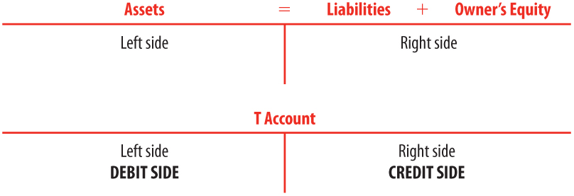
Accounts
Lesson 2-1
LO2

Slide 5
Increases, Decreases, and Balances in Accounts
Lesson 2-1
LO3
Assets
On the left side of the accounting equation
Increase on the left, or debit, side of the account
Liabilities and the owner’s capital account
On the right side of the accounting equation
Increase on the right, or credit, side of the account
Normal balance
The side of the account that is increased is called the normal balance of the account.
Assets have normal debit balances
Liabilities and the owner’s capital account have normal credit balances

Slide 6
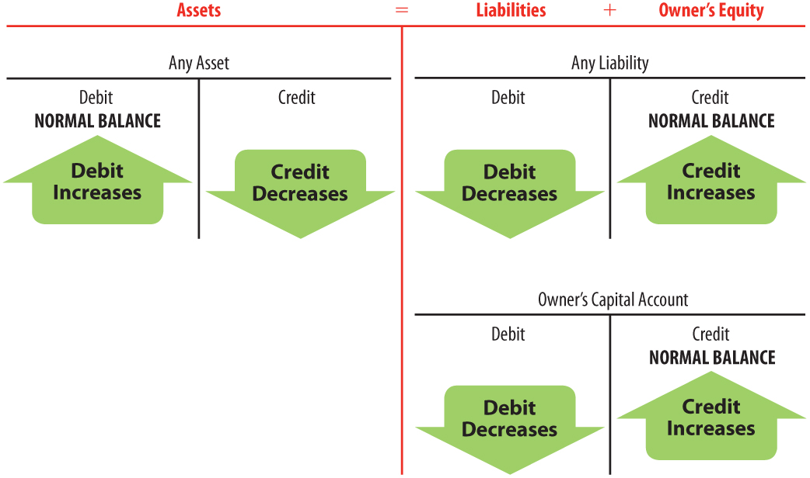
Increases, Decreases, and Balances in Accounts
Lesson 2-1
LO3
assets increase on debit side
decrease on credit side
record on your note card
liabilities & owner’s equity
increase on credit side
decrease on debit side
record on your note card

Slide 7

Lesson 2-1 Audit Your Understanding
Lesson 2-1
1. Draw the accounting equation on a T account.
ANSWER

Slide 8
Lesson 2-1 Audit Your Understanding
Lesson 2-1
2. What are the two accounting rules that explain increases of account balances?
ANSWER
(1) Assets are on the left side of the accounting equation. Therefore, assets increase on the left, or debit, side of the account.
(2) Liabilities and the owner’s capital account are on the right side of the accounting equation. Therefore, liabilities and the owner’s capital account increase on the right, or credit, side of the account.

Slide 9

Learning Objectives
LO4 Restate and apply the four questions necessary to analyze transactions for starting a business into debit and credit parts.
© 2014 Cengage Learning. All Rights Reserved.

Slide 10
Chart of Accounts
Lesson 2-2
Each transaction changes the balances of at least two accounts.
A list of accounts used by a business is called a chart of accounts.

Slide 11
Chart of Accounts for Delgado Web Services
Lesson 2-2
Balance Sheet Accounts
(100) ASSETS
110 Cash
120 Petty Cash
130 Accounts Receivable—Main Street Services
140 Accounts Receivable—Valley Landscaping
150 Supplies
160 Prepaid Insurance
(200) LIABILITIES
210 Accounts Payable—Canyon Office Supplies
220 Accounts Payable—Mountain Graphic Arts
(300) OWNER’S EQUITY
310 Michael Delgado, Capital
320 Michael Delgado, Drawing
330 Income Summary
Income Statement Accounts
(400) REVENUE
410 Sales
(500) EXPENSES
510 Advertising Expense
520 Cash Short and Over
530 Communications Expense
540 Equipment Rental Expense
550 Insurance Expense
560 Miscellaneous Expense
570 Supplies Expense

Slide 12
Analyzing Transactions
Questions for analyzing transactions
1. Which accounts are affected?
2. How is each account classified?
3. How is each classification changed?
4. How is each amount entered in the accounts?

Slide 13
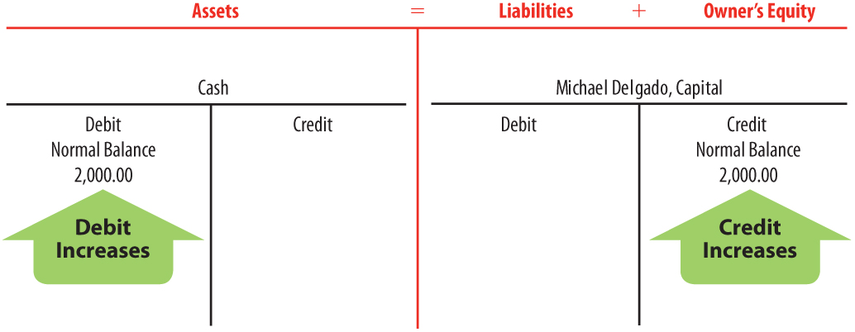
Received Cash from Owner as an Investment
Lesson 2-2
LO4
January 2. Received cash from owner as an investment, $2,000.00.
1
Cash and Michael Delgado, Capital are affected.
2
Cash is an asset account.
2
Michael Delgado, Capital is an owner‘s equity account.
4
Cash is debited.
4
Michael Delgado,
Capital is credited.
3
Assets are increased.
3
Owner’s Equity is increased.

Slide 14
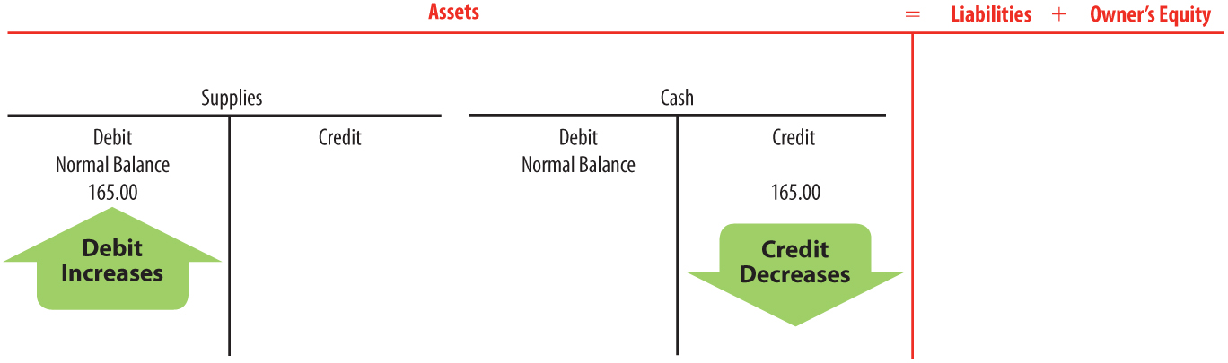
Paid Cash for Supplies
Lesson 2-2
LO4
January 2. Paid cash for supplies, $165.00.
1
Supplies and Cash are affected.
2
Supplies and Cash are assets.
4
4
Supplies is debited.
Cash is credited.
3
Assets (Supplies) are increased.
3
Assets (Cash) are decreased.

Slide 15
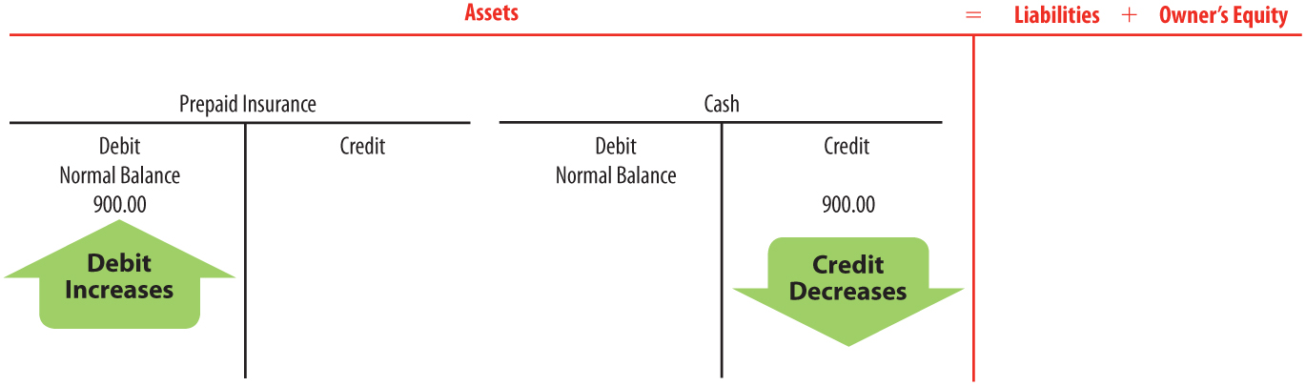
Paid Cash for Insurance
Lesson 2-2
LO4
January 3. Paid cash for insurance, $900.00.
2
Prepaid Insurance and Cash are assets.
1
Prepaid Insurance and Cash are affected.
4
4
Prepaid Insurance is debited.
Cash is credited.
3
Assets (Prepaid Insurance) are increased.
3
Assets (Cash) are decreased.

Slide 16
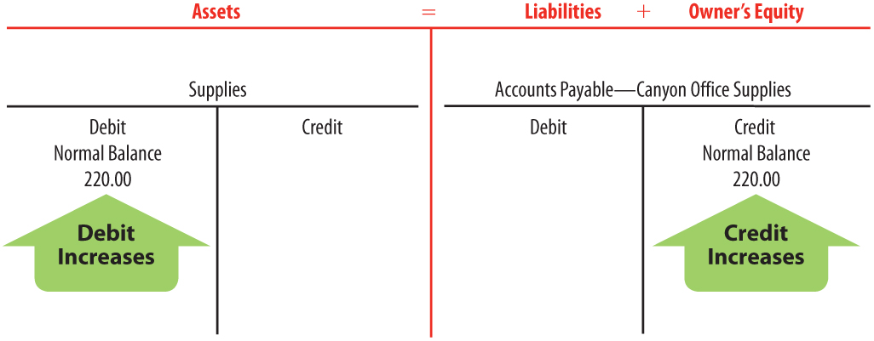
Bought Supplies on Account
Lesson 2-2
LO4
January 5. Bought supplies on account from Canyon Office Supplies, $220.00.
Supplies and Accounts Payable—Canyon Office Supplies are affected.
1
2
Supplies is an asset.
2
Accounts Payable—
Canyon Office
Supplies is a
liability.
4
Supplies is debited.
4
Accounts Payable—
Canyon Office
Supplies is credited.
3
Assets are increased.
3
Liabilities are increased.

Slide 17
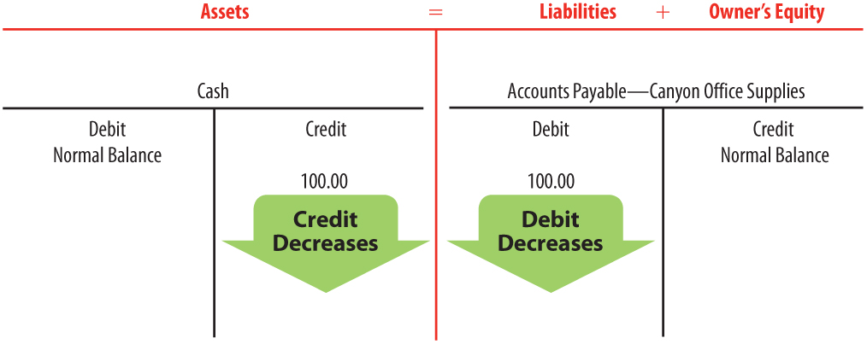
Paid Cash on Account
Lesson 2-2
LO4
January 9. Paid cash on account to Canyon Office Supplies, $100.00.
Accounts Payable—Canyon Office Supplies
and Cash are affected.
1
2
Cash is an asset.
2
Accounts Payable—
Canyon Office
Supplies is a
liability.
4
4
Cash is
credited.
Accounts Payable—
Canyon Office
Supplies is debited.
Assets are decreased.
Liabilities are decreased.
3
3

Slide 18
Lesson 2-2 Audit Your Understanding
Lesson 2-2
1. State the four questions used to analyze a transaction.
ANSWER
1. Which accounts are affected?
2. How is each account classified?
3. How is each classification changed?
4. How is each amount entered in the accounts?

Slide 19
Lesson 2-2 Audit Your Understanding
Lesson 2-2
2. Which two accounts are affected when a business buys supplies on account?
ANSWER
Supplies
Accounts Payable

Slide 20
on your own 2-2
Open Excel. Open the 2-2 spreadsheet.
Enter your name and complete the problems.
Ensure OK is visible.
When you submit, ensure the OK are all visible.
Names and numbers are not the same as book.

Slide 21
Application Problems
2-1 Application Problem
2-2 Application Problem

Slide 22

Learning Objectives
LO5 Analyze transactions for operating a business into debit and credit parts.
© 2014 Cengage Learning. All Rights Reserved.

Slide 23
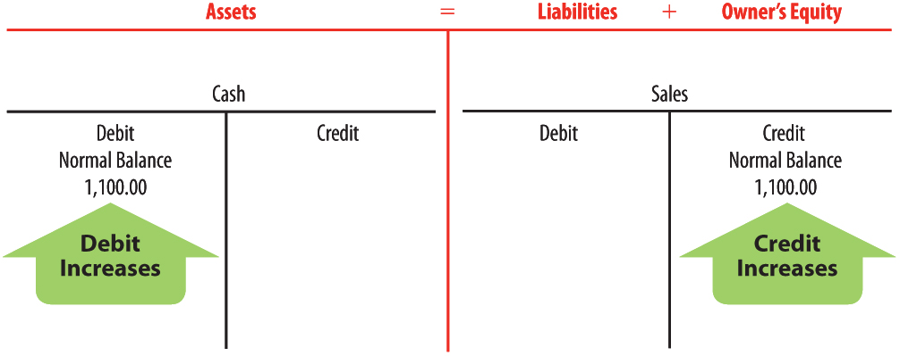
Received Cash from Sales
Lesson 2-3
LO5
January 10. Received cash from sales, $1,100.00.
Write sales on owner’s equity side of card
2
1
Cash and Sales are affected.
Sales is a
revenue account
that affects
owner‘s equity.
Cash is an asset.
2
4
4
Cash is
debited.
Sales is credited.
3
Assets are increased.
3
Owner’s equity is increased.

Slide 24
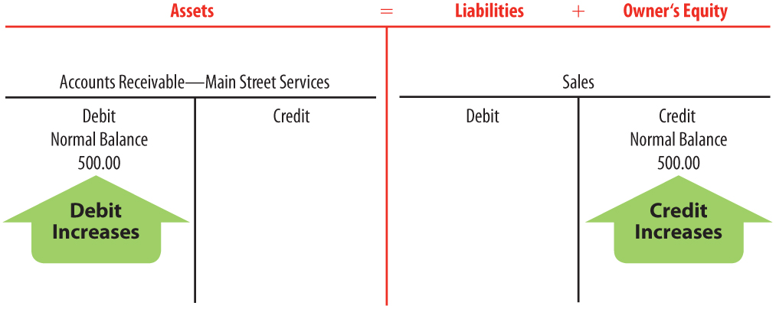
Sold Services on Account
Lesson 2-3
LO5
January 12. Sold services on account to Main Street Services, $500.00.
2
Accounts Receivable—
Main Street Services is an asset.
Accounts Receivable—Main Street Services and Sales are affected.
1
2
Sales is a
revenue
account
that affects
owner's
equity.
4
4
Accounts
Receivable—
Main Street
Services is
debited.
Sales is credited.
3
Assets are increased.
3
Owner’s equity is increased.

Slide 25
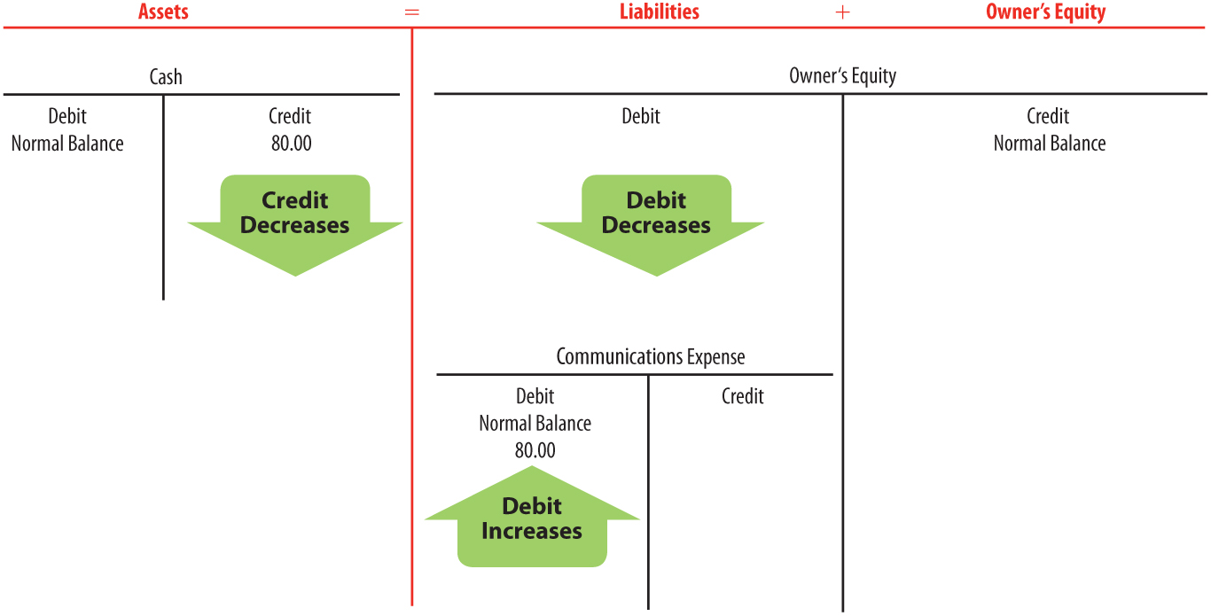
Paid Cash for an Expense
Lesson 2-3
LO5
January 12. Paid cash for communications bill for cell phone and Internet service, $80.00.
Communications Expense and Cash are affected.
Communications Expense is an expense account that affects owner‘s equity.
2
Cash is an asset.
1
2
4
Cash is credited.
Write (expense) on owner’s equity side of card
Assets are
decreased.
3
Owner‘s equity is decreased; expenses are increased.
Communications
Expense is debited.
4
3

Slide 26
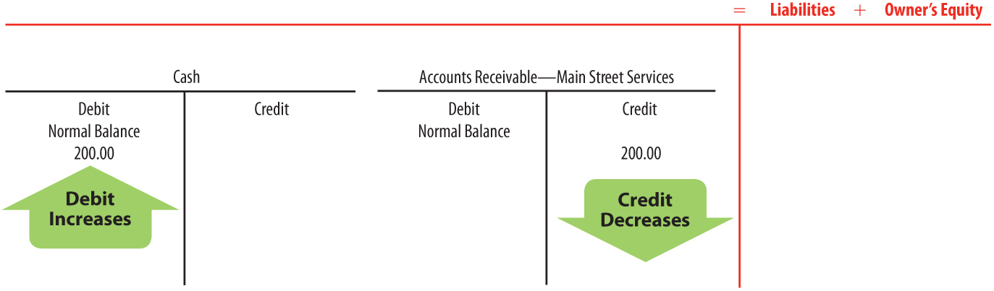
Received Cash on Account
Lesson 2-3
LO5
January 16. Received cash on account from Main Street Services, $200.00.
2
Cash and Accounts Receivable—
Main Street Services are assets.
1
Cash and Accounts Receivable—
Main Street Services are affected.
Assets
= Liabilities + Owner’s Equity
Accounts Receivable—
Main Street Services
is credited.
4
4
Cash is debited.
3
Assets (Cash) are increased.
3
Assets (Accounts Receivable—
Main Street Services) are decreased.

Slide 27
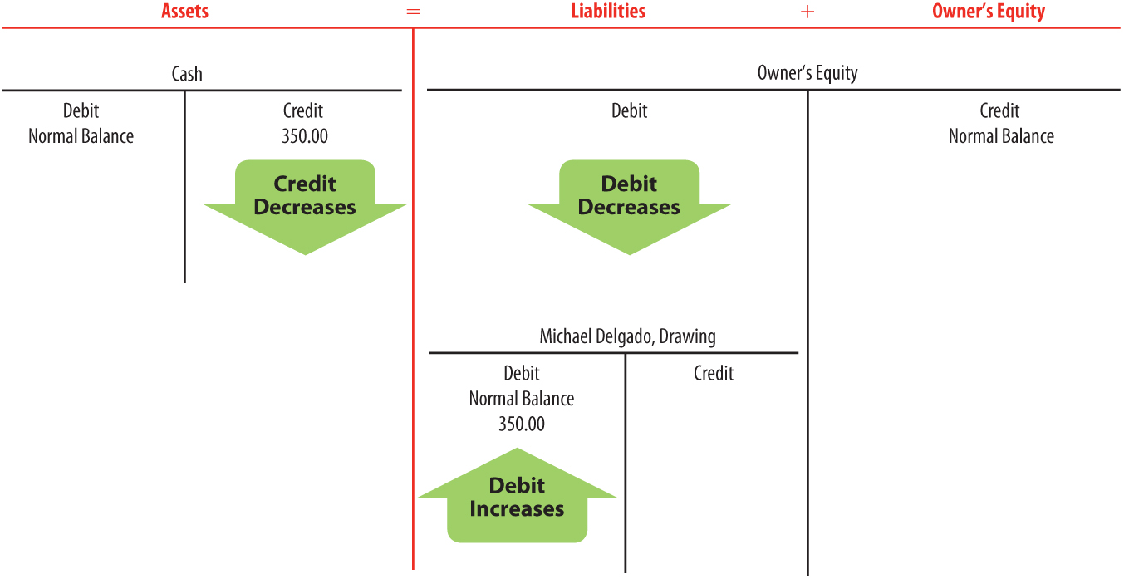
Paid Cash to Owner for Personal Use
Lesson 2-3
LO5
January 16. Michael Delgado withdrew equity in the form of cash, $350.00.
2
Cash is an asset.
1
Michael Delgado, Drawing and Cash are affected.
Write (Drawing) on owner’s equity side of card
4
Cash is credited.
Michael Delgado, Drawing is an owner‘s equity account.
2
3
Assets are decreased.
4
Michael Delgado, Drawing is debited.
3
Owner’s equity is decreased; withdrawals are increased.

Slide 28
Lesson 2-3 Audit Your Understanding
Lesson 2-3
1. Which two accounts are affected when a business pays cash for a cell phone bill?
ANSWER
Communications Expense
Cash

Slide 29
Lesson 2-3 Audit Your Understanding
Lesson 2-3
2. Which two accounts are affected when a business sells services on account?
ANSWER
Accounts Receivable
Sales

Slide 30
Lesson 2-3 Audit Your Understanding
Lesson 2-3
3. Which two accounts are affected when a business receives cash on account?
ANSWER
Cash
Accounts Receivable

Slide 31
Lesson 2-3 Audit Your Understanding
Lesson 2-3
4. Is the drawing account increased on the debit side or credit side?
ANSWER
Debit because withdrawals decrease owner’s equity

Slide 32
Lesson 2-3 Audit Your Understanding
Lesson 2-3
5. Are revenue accounts increased on the debit side or credit side?
ANSWER
Credit because revenue increases owner’s equity

Slide 33
Owner Withdrawals vs Salary What is the difference?
Owner withdrawal is not an expense
Owner is just taking back out part of money they invested
Withdrawal is not taxed by the Internal Revenue Service (IRS)
Proprietorships are not assessed corporate income taxes by the IRS
Owner must report their Net Income at the end of the year on their personal Form 1040 tax return and file with the IRS
Owner who earns salary also would have to report the salary and the Net Income.
Since salary is an expense – would reduce Net Income, so cash received would be same.
However, there may be tax deductions you can take as proprietorship that you can’t take for salary amount. Check with tax preparer.

Slide 34
Work Together 2-3 On You Own 2-3
Work Together
Model
Self-Correcting Excel
Problem outside of text
On Your Own
Complete
Self-Correcting Excel
Problem outside of text

Slide 35
Application Problems
2-3 Application Problem
Self-Correcting Excel
Problem outside of text
2-4 Application Problem
Self-Correcting Excel
Problem outside of text

Slide 36
Unit 2 Assessment
Unit 2 Review (ExamView)
90 % or Greater
5 Point Bonus on Unit 1 Concept Quiz (20% Bonus)
Unit 2 Part 1 Quiz (ExamView)
Concepts – 25 Questions (25 Points)
Unit 2 Part 2 Quiz (Excel)
Skills (35 Point)

